Slide 1
Innovation greater manchester
Making Greater Manchester a national engine of growth at the heart of the Northern Powerhouse

Slide 2
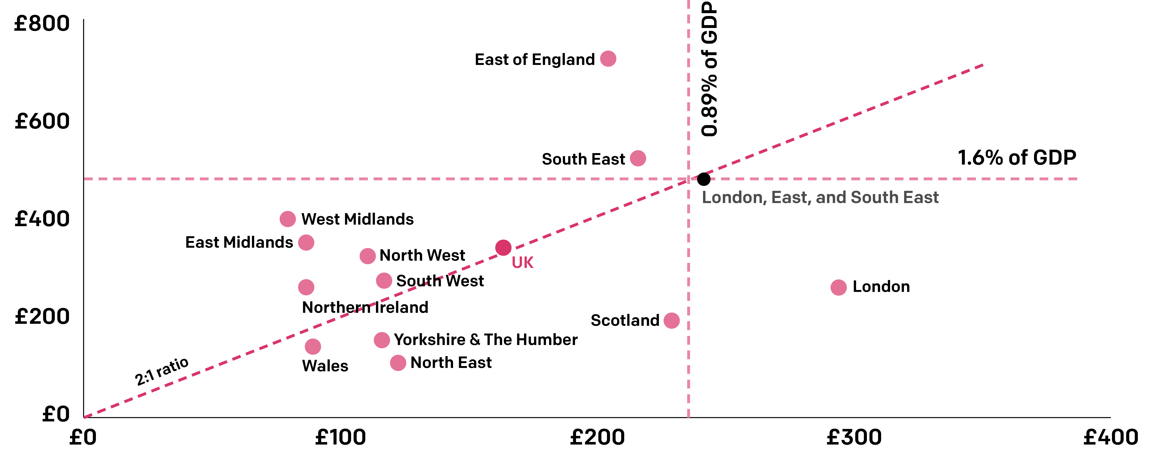
The direct benefits of R&D investment aren’t felt evenly across the UK
Spending on R&D by NUT51 region within the UK, 2016 (split by market-led (business) and non-market-led (government and charity)
Business spending on R&D, £/resident
Government, university, and charity spending on R&D, £/resident
Regional distribution of UK R&D spending by NUTS1 region, expressed per resident for market-led and non-market-led sectors.

Slide 3
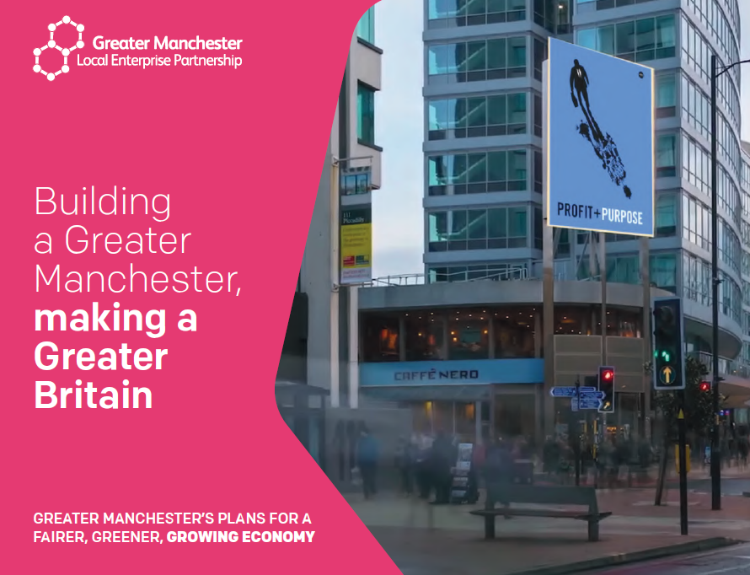
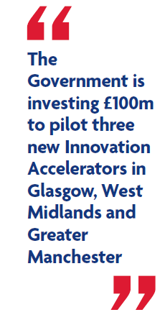
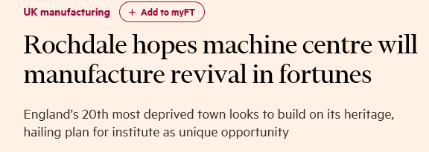
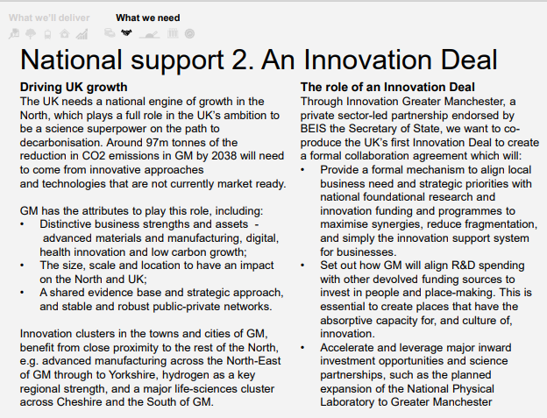
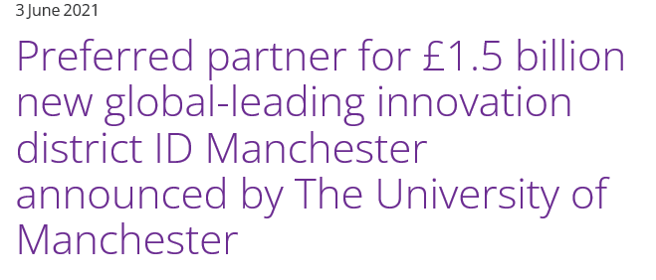
Innovation Greater Manchester
Innovation Greater Manchester came together to drive the city-region’s post-COVID economic recovery (2020)
Part of a new economic vision for the city-region – a Fairer, Greener, Growing Economy and with innovation at its core
Business led; enabled by universities and wider public sector
Future Economic vision
Prospectus to SR 20
Innovation Greater Manchester
Submission to SR 21
Levelling Up Whitepaper

Slide 4
A bold vision to 2030 to drive innovation-led economic growth across the whole conurbation
By 2030 Greater Manchester will be known globally for its innovation ecosystem and as a leader of the fourth industrial revolution.
This will be driven by an intense focus on our global strengths - in advanced materials and manufacturing, health innovation, digital and creative and green technologies. Alongside investing in scientific excellence we will build an environment where we more systematically commercialise this through existing firms, new players and investors in the city region and start ups. We will create a skills and talent pipeline, access to finance and deeper business networks that fuel enterprise and entrepreneurship.
Success will mean more high quality jobs and more productive firms across all areas of the conurbation and in all our sectors. Innovation will characterise our whole economy which will be built on high quality productive jobs that support improvements for our communities - where we see increased skills, better opportunities and consequent improvements to health and reduced inequality.
Our approach will be to work collaboratively with other city regions and clusters to catalyse a new Innovation Nation.

Slide 5
What are we trying to achieve?
Catalysing innovation-led growth in more places by building innovation capacity as a key input to overcoming sustained economic underperformance
Attracting frontier firms from elsewhere
Supporting indigenous firms to become more productive
Creating and scaling-up entirely new frontier firms
Contextual factors shape the optimal balance between these three routes depending on the existing strengths and opportunities of places but in all cases evidence shows it is critical to bring together a plan that coalesces
Support to enable business-led r&d
Talent & human capital
Investment in wider infrastructure
This is the Greater Manchester Blueprint – a plan for our assets, places, and people

Slide 6
Triple-helix board – led by industry
Chris Oglesby
Bruntwood
Chair
Juergen Maier
Graphene & Advanced Materials Manufacturing Alliance
Advanced Materials & Manufacturing
Vic Knight
BAE Systems
Digital Security
Pete Emery
Electricity North-West
Net Zero
University vice chancellors of Manchester, Manchester Met & Salford
Joanne Roney, Manchester City Council
Economy
Tom Stannard, Salford Council
Skills
Professor Richard Jones
Independent Science Advisor
Health Innovation business lead (tbc)
Lou Cordwell, Magnetic North
Creative & Digital
Inclusive economy business lead (tbc)
Eamon Boylan, GMCA
Investment
Investor voice (tbc)
Innovation Greater Manchester
Board
Public
Academia
Private
Independent science advisor

Slide 7
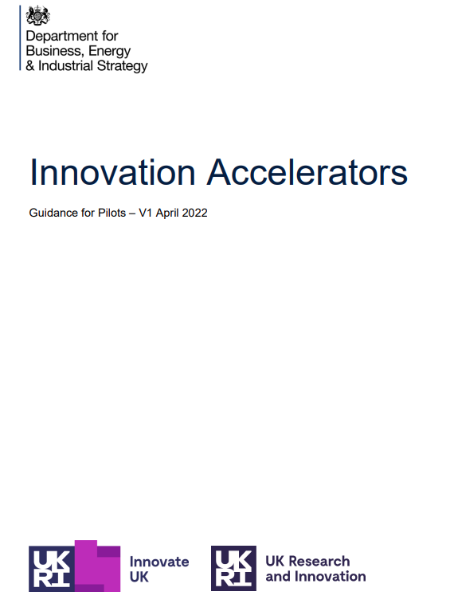
A catalyst investment underpinned by a new relationship built around co-design with Innovate UK and UKRI
Policy and regulatory flexibilities alongside access to a share of a £100m
A pilot for potential replicability, proving the case ahead of Spending Review 25

Slide 8
Innovation accelerator pilot objectives
Stimulate economic and productivity growth by supporting the three city regions to grow their innovation strengths, build greater capacity and capability to perform high quality applied and translational R&D, and increase private R&D investment.
Drive stronger local economic and social benefits from new and existing R&D investments in the three city regions, including through strengthening the clusters’ connections with areas of lower productivity.
Strengthen partnerships between local government, industry, universities and other R&D institutions for the benefit of local innovation ecosystems.
Address policy and regulatory barriers to developing local innovation ecosystems through the provision of tailored Government support and greater alignment of national R&D priorities with local objectives.
Understand the effectiveness of the Innovation Accelerator model to inform future policy measures, particularly whether enhanced local collaborations and dedicated cross-government support can drive improved outcomes

Slide 9
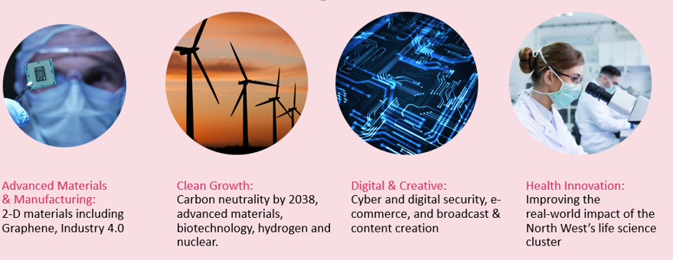
Investing in innovation assets to connect research to real-world challenges
Translating GM’s science and innovation strengths in advanced materials & manufacturing, health innovation, digital & creative, and low carbon into productivity gains and growth across GM and beyond
Innovation GM will invest in pioneering research institutes and and centres of excellence, to boost their translational capacity to a broader base of businesses
Levelling Up Missions
Greater Manchester Frontier Sectors
Productivity AND
Skills
Digital
Pride in place
Innovating to address local challenges
Health Inequalities
Net zero 2038
Good employment

Slide 10
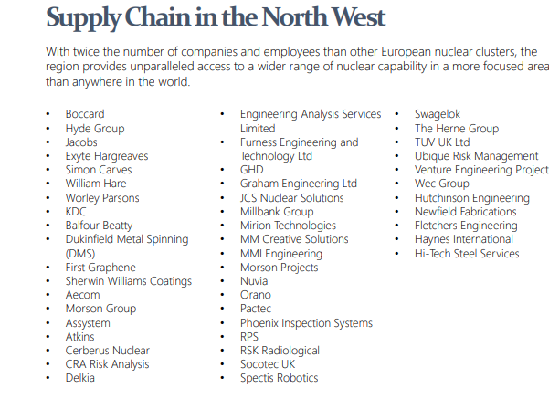
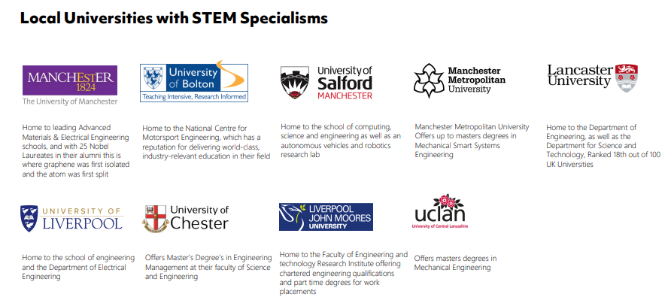
Cumbria and Greater Manchester - Nuclear and advanced manufacturing example

